Slide 1

SMOKE DETECTOR AND FIRE PREVENTION
18CSS302J - Computer Networks ( MINI PROJECT)
P.PHANI SWAROOP
N.V.V.GANESH
A.UDAY KIRAN
VARUN KHAREEDU

Slide 2
Problem Statement and Identifying Objectives
PROJECT OBJECTIVE :
Designing smoke detector with fire prevention in a smart home with Internet of Things (Iot) .

Slide 3
PROJECT OVERVIEW
We propose to design a simple network for fire detection and prevention with the help of Cisco Packet Tracer. We can design a smart home network with the help of IoT.
These smoke & fire detection systems use automatic functions to detect the occurrence of an event that may result in a fire.
This project discusses the automatic fire detection system, composition, and working principle. The overall structure of the fire detection system and control software in the design.

Slide 4
NETWORKING OVERVIEW
Computers and Information are critical to the success of almost any project or business, be it large or small and this is where networking comes into play.
They help connect people, support applications and services and also provide access to multiple resources.
Some of those steps one should follow to build a good network:
Verifying our Goals
Identifying and assessing the requirements
Creating a proper plan
Building the network.

Slide 5
Comparing and contrasting selected method to other alternative methods

Slide 6
Why we need smoke detector in a Smart Home
According to the National Fire Protection Association, 50%of all fatal home fires occur while people are sleeping.
Here are a few reasons why you need smoke detector in a smart home.
To avoid fire accidents
To prevent property loss
To save valuable lives
They stand guard around the clock
Convenience and Eﬃciency
Prevention is better than cure

Slide 7
What is special about our Project?
Our smoke detector will be automated.
Our smart detection can make our lives secure.
The most important thing is the owner of the house can access the house with the help of his/her smartphone/Laptop.
In our project, we not only detects smoke but also prevent fire .
It also timely detects the fireplace which plays vital role in avoiding a serious accident.
Low-cost fire detection and control system.

Slide 8
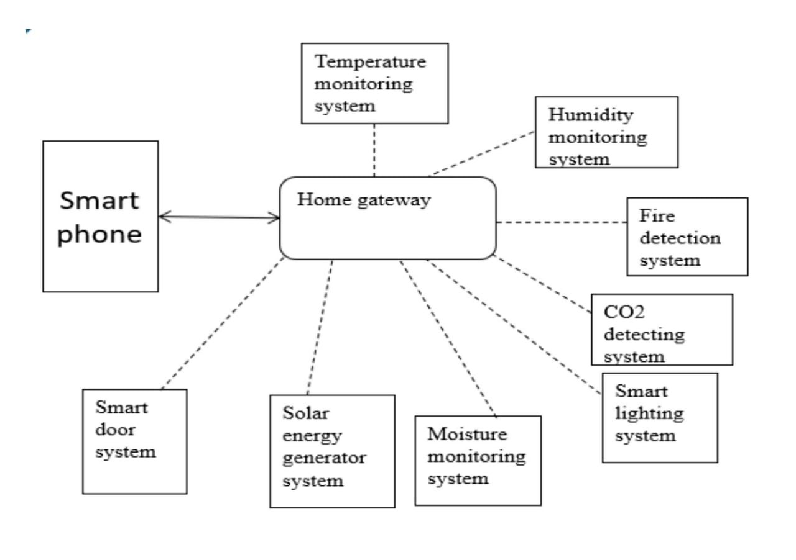
FLOW CHART

Slide 9
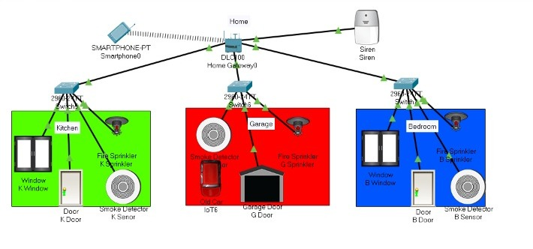
NETWORK DESIGN

Slide 10
IMPLEMENTATION
Setting up same SSID to the network.
Enabling the network adaptor to all the devices and following DHCP protocol.
Configuring EIGRP routing protocol and creating DNS server.
Now we set up the smoke detector and sprinklers in every room.
Next we provide with the certain conditions in our smartphone for the function of IOT devices.

Slide 11
Identifying Functionalities and Computing Resources

Slide 12
COMPONENTS:-
Smoke detectors
Fire sprinkler
Windows
Doors
Garage door
Siren
Home Gateway
Switch
Smart device

Slide 13
FUNCTIONALITIES:-
All the users and IOT devices should share internet connection.
The smoke detectors should function properly.
The smartphones should be able to connect to all the IOT devices.
Sprinklers and windows should shut down immediately after smoke goes off.

Slide 14
THANK YOU

